Slide 1
Lesson 3: DCIPS Occupational Structure
Duration: 45 minutes
DCIPS Occupational Structure
Slide 3- 1

Slide 2
Lesson 3 Topics
Lesson 3 Topics
Topic 1 – DCIPS Occupational Structure
Topic 2 –Grades and Pay Bands
Topic 3 – Occupational Groups
DCIPS Occupational Structure
Slide 3- 2

Slide 3
Key Terms
Can you Define These Key Terms?
Mission Categories
Work Categories
Work Levels
DCIPS Grades/DCIPS Pay Bands
Occupational Groups
DCIPS Occupational Structure
Slide 3- 3

Slide 4
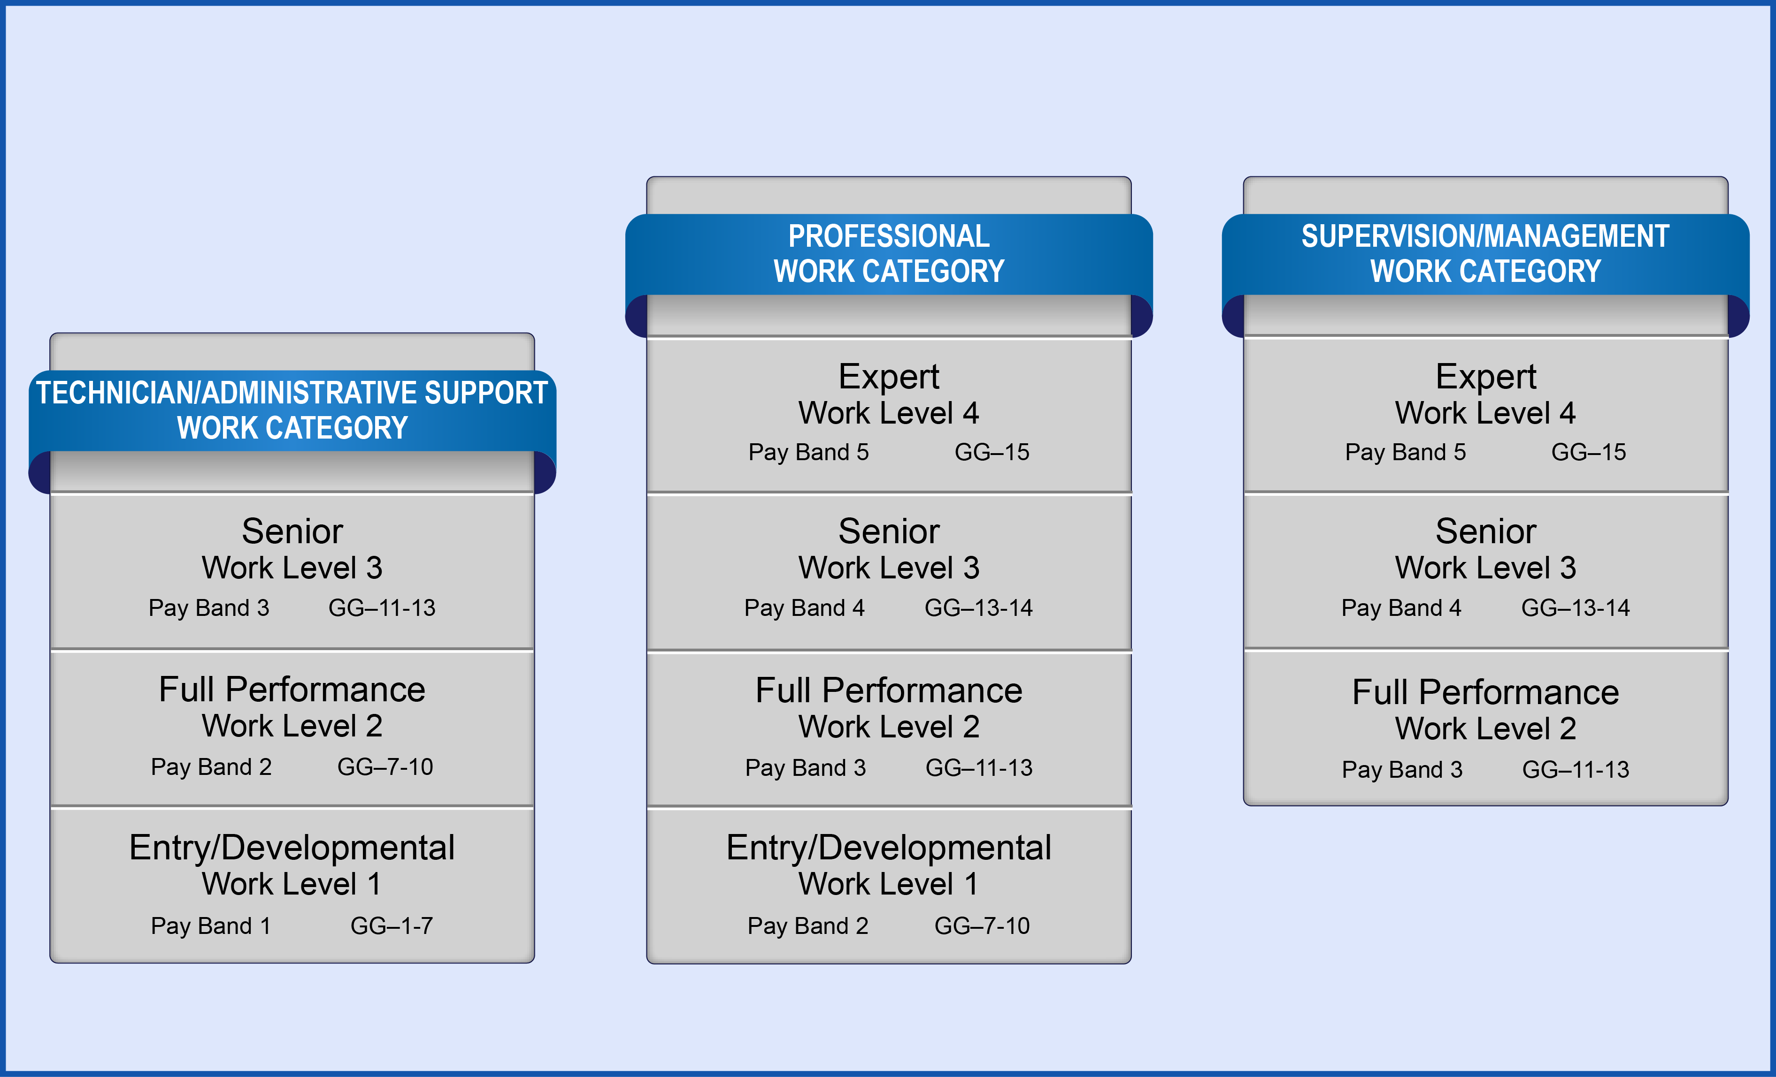
Position Alignment
Position Alignment
DCIPS Occupational Structure
Alignment relates to the placement of positions in the DCIPS Occupational Structure and follows a top-down approach
DCIPS Occupational Structure
Slide 3- 4

Slide 5
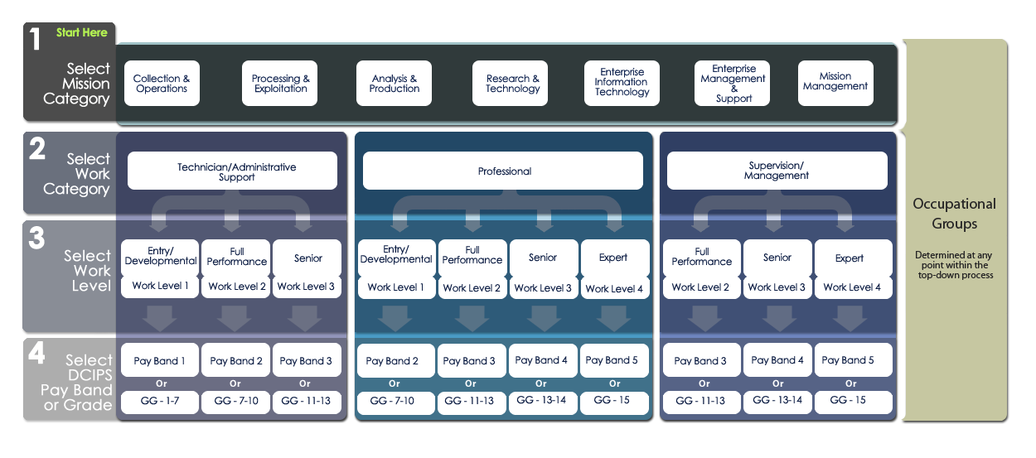
Alignment Process
Top-Down Alignment Process
DCIPS Occupational Structure
Slide 3- 5

Slide 6
DCIPS Occupational Structure
Overview of DCIPS Occupational Structure
DCIPS Occupational Structure
DCIPS Occupational Structure
Slide 3- 6

Slide 7
Occupational Structure Benefits
Benefits of DCIPS Occupational Structure
Promotes consistency across the Enterprise
Helps the Enterprise recruit for DCIPS positions
Helps the Enterprise conduct strategic workforce planning in order to ensure the right people are in the right places to meet evolving mission requirements
Supports employee understanding, making it easier for individuals under career progression to transfer within the Enterprise
Helps facilitate Joint Duty Assignments between Defense Intelligence Components and other members of the IC
DCIPS Occupational Structure
Slide 3- 7

Slide 8
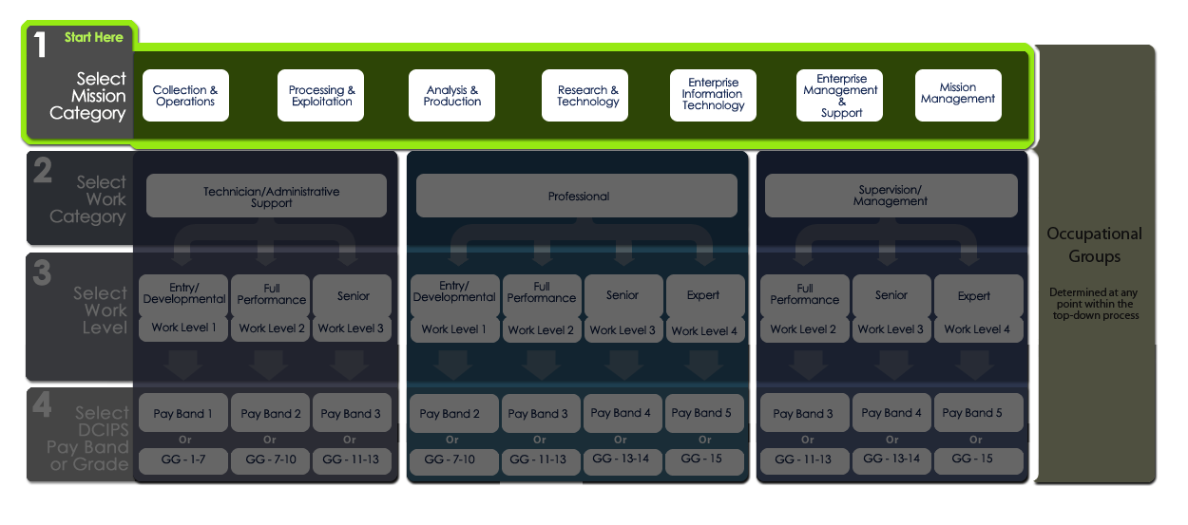
Step 1: Select Mission Category
Step 1: Select Mission Category
DCIPS Occupational Structure
Slide 3- 8

Slide 9
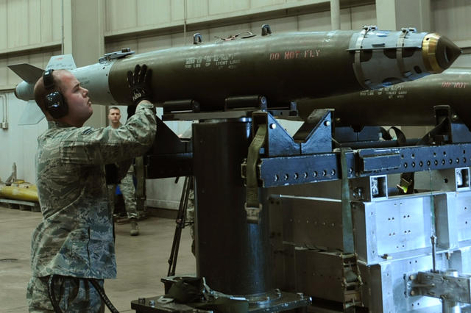
Mission Categories Defined
Mission Categories Defined
Collection and Operations
Processing and Exploitation
Analysis and Production
Research and Technology
Enterprise Information Technology
Enterprise Management and Support
Mission Management
DCIPS Occupational Structure
Slide 3- 9

Slide 10
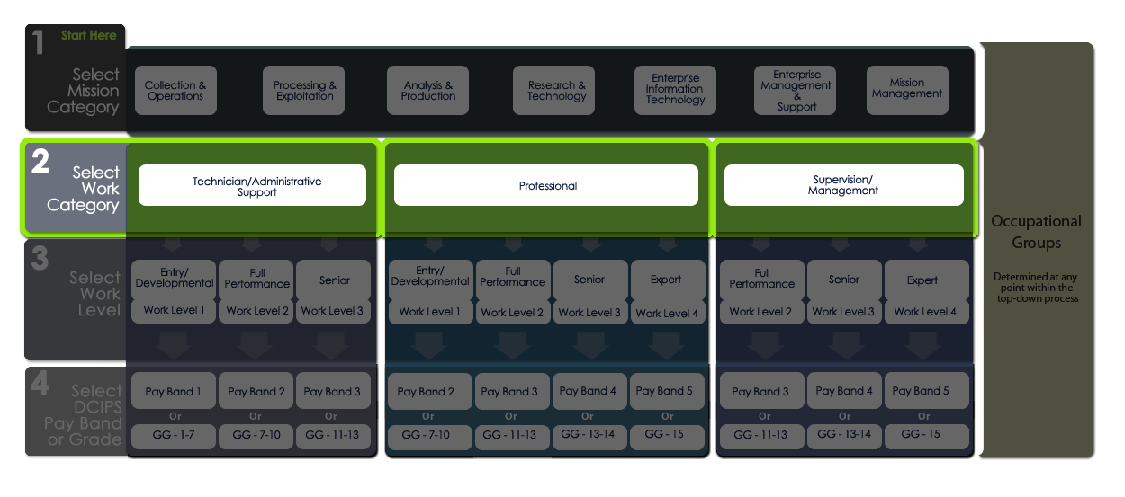
Step 2: Select Work Category
Step 2: Select Work Category
DCIPS Occupational Structure
Slide 3- 10

Slide 11
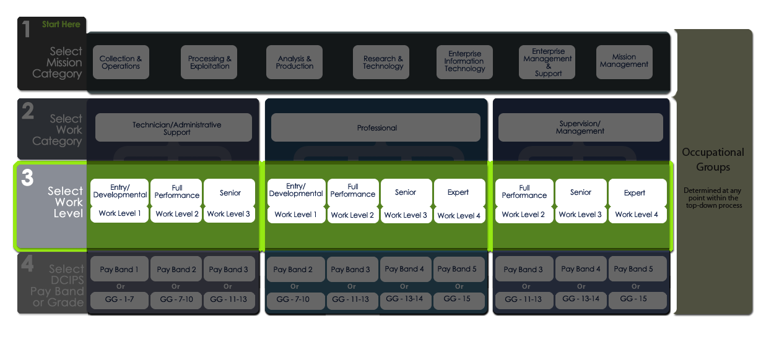
Step 3: Select Work Level
Step 3: Select Work Level
DCIPS Occupational Structure
Slide 3- 11

Slide 12
Work Levels and Work Categories
Work Levels and Work Categories
DCIPS Occupational Structure
Slide 3- 12

Slide 13
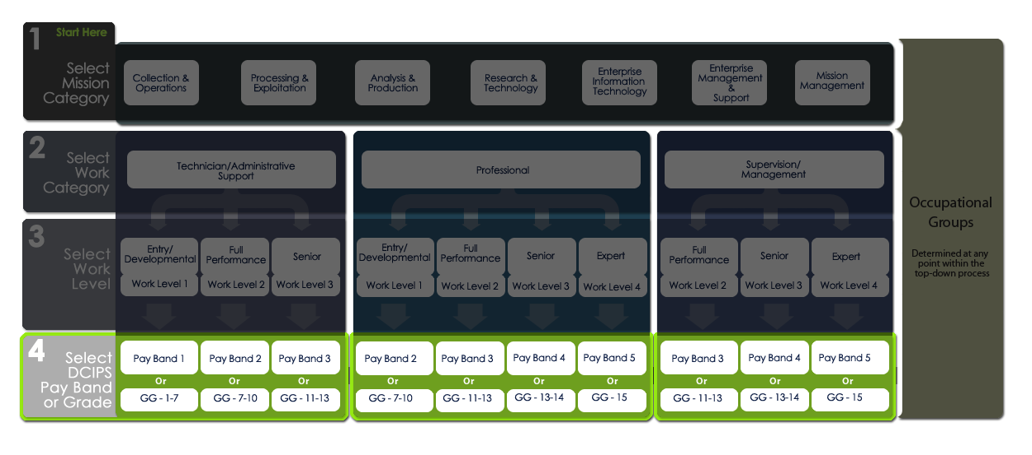
Step 4: Select Pay Band or Grade
Step 4: Select Pay Band or Grade
DCIPS Occupational Structure
Slide 3- 13

Slide 14
Common Work Level
Common Work Level
DCIPS Occupational Structure
Slide 3- 14

Slide 15
Pay Bands and Grades within Work Levels
Pay Bands and Grades within Work Levels
DCIPS Occupational Structure
Slide 3- 15

Slide 16
Step 4: Select DCIPS Pay Band or Grade
Step 4: Select DCIPS Pay Band or Grade
DCIPS Occupational Structure
Slide 3- 16

Slide 17
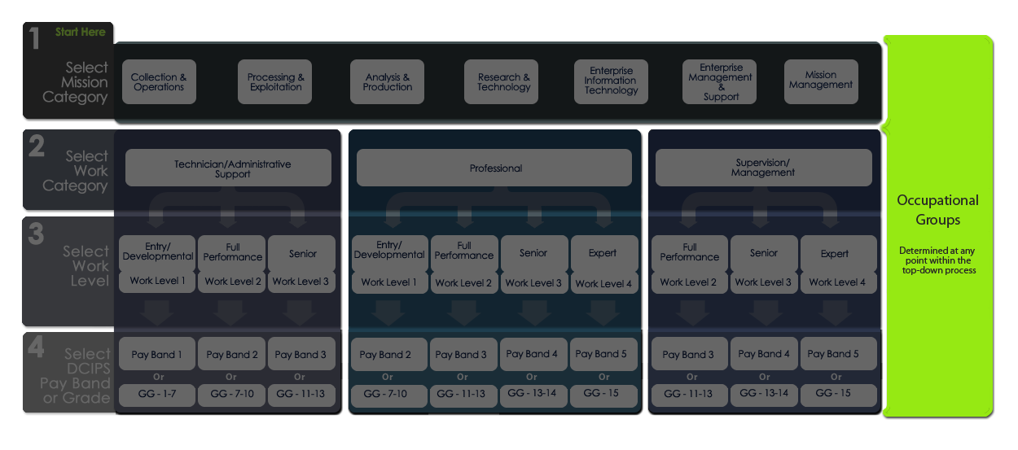
Occupational Groups
Occupational Groups
DCIPS Occupational Structure
Slide 3- 17

Slide 18
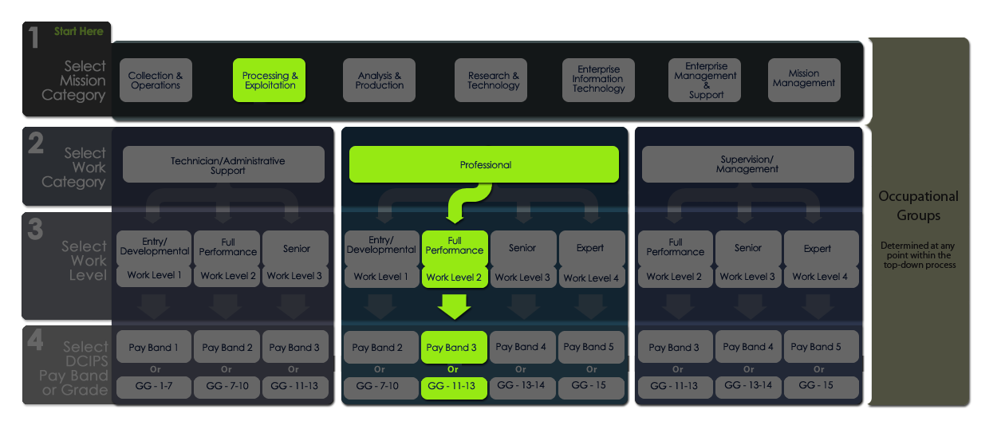
Top-Down Alignment Approach
Top-Down Alignment Approach
DCIPS Occupational Structure
Slide 3- 18

Slide 19
Lesson 3 Review
Lesson 3 Review
Topic 1 – DCIPS Occupational Structure
Topic 2 – DCIPS Grades and Pay Bands
Topic 3 – Occupational Groups
Slide 3- 19
DCIPS Occupational Structure
Slide 3- 2

